Slide 1
Edges
Slides Acknowledgements
Steve Seitz
Kirsten Grauman,
Other Vision Researchers
Ebook: R. Szeliski

Slide 2
Recall: image filtering
Compute a function of the local neighborhood at each pixel in the image
Function specified by a “filter” or mask saying how to combine values from neighbors.
Uses of filtering:
Enhance an image (denoise, resize, etc)
Extract information (texture, edges, etc)
Detect patterns (template matching)
Adapted from Derek Hoiem

Slide 3
Edge detection
Goal: map image from 2d array of pixels to a set of curves or line segments or contours.
Why?
Main idea: look for strong gradients, post-process
Figure from J. Shotton et al., PAMI 2007

Slide 4
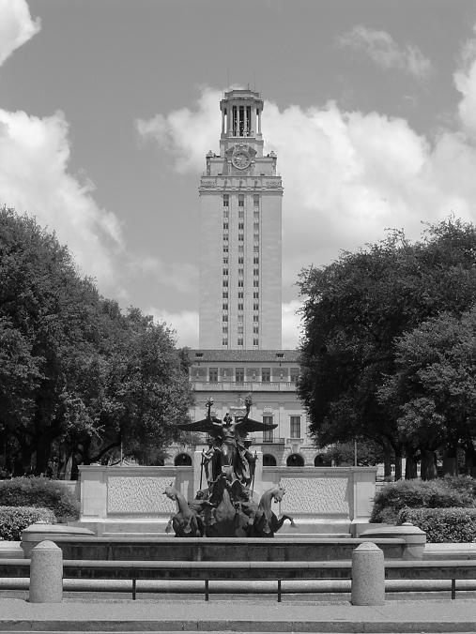
What causes an edge?
Depth discontinuity: object boundary
Reflectance change: appearance information, texture
Cast shadows
Change in surface orientation: shape
Kristen Grauman, UT-Austin

Slide 5
Edges/gradients and invariance
Kristen Grauman, UT-Austin

Slide 6

Derivatives and edges
An edge is a place of rapid change in the image intensity function.
intensity function (along horizontal scanline)
image
first derivative
edges correspond to extrema of derivative
Source: L. Lazebnik

Slide 7
Derivatives with convolution
For 2D function, f(x,y), the partial derivative is:
For discrete data, we can approximate using finite differences:
To implement above as convolution, what would be the associated filter?

Slide 8
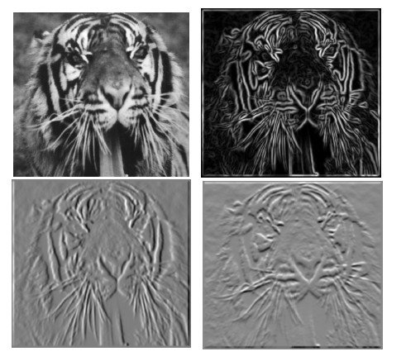
Partial derivatives of an image
?
-1 1
1 -1
-1 1
or
Which shows changes with respect to x?
(showing filters for correlation)

Slide 9
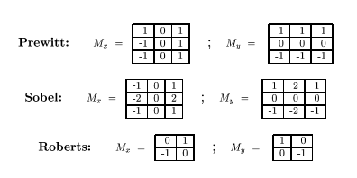
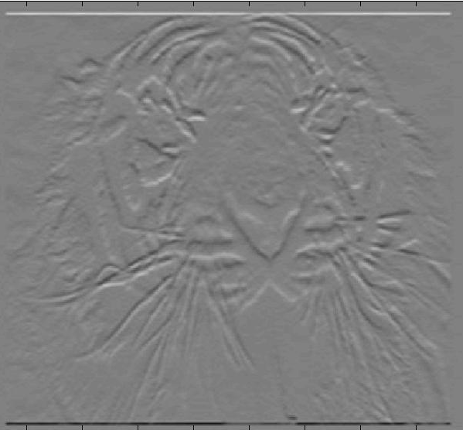
Assorted Finite Difference Filters

Slide 10
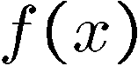
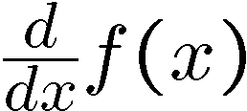
Effects of noise
Consider a single row or column of the image
Plotting intensity as a function of position gives a signal
Where is the edge?
Slide credit Steve Seitz

Slide 11


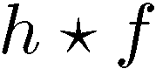
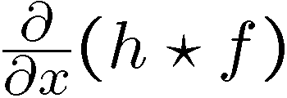
Solution: smooth first
Where is the edge?
Look for peaks in

Slide 12
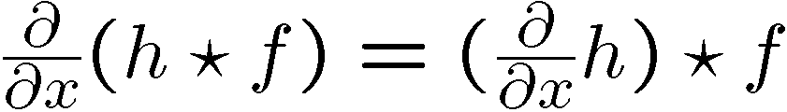
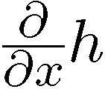
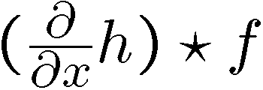
Derivative theorem of convolution
Differentiation
property of
convolution.
Slide credit Steve Seitz

Slide 13
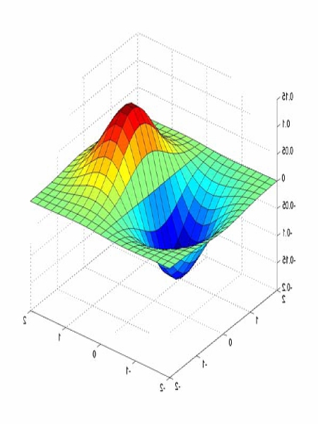
Derivative of Gaussian filters
0.0030 0.0133 0.0219 0.0133 0.0030
0.0133 0.0596 0.0983 0.0596 0.0133
0.0219 0.0983 0.1621 0.0983 0.0219
0.0133 0.0596 0.0983 0.0596 0.0133
0.0030 0.0133 0.0219 0.0133 0.0030

Slide 14
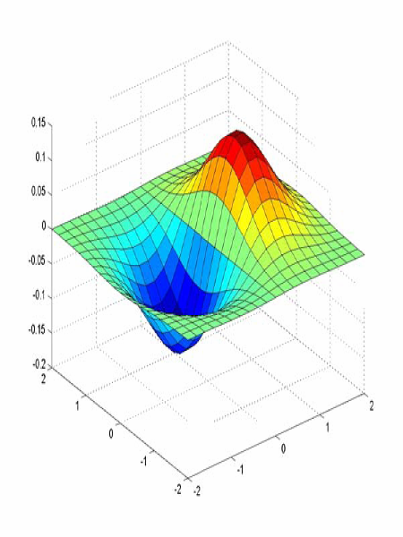
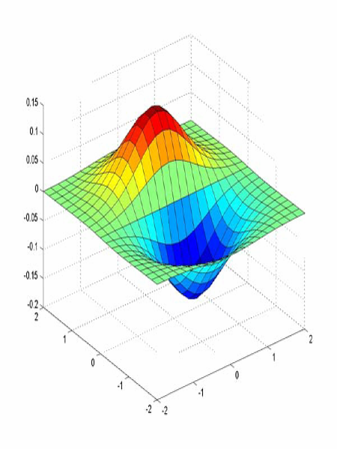
Derivative of Gaussian filters
x-direction
y-direction
Source: L. Lazebnik

Slide 15
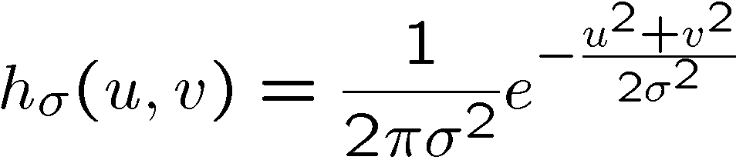
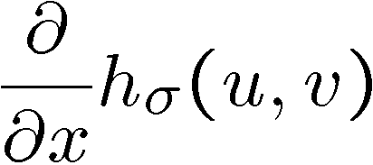
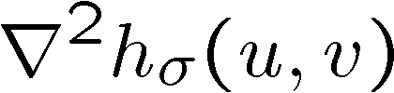
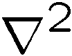
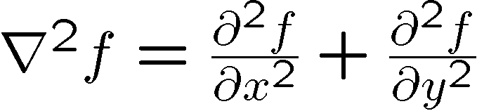
2D edge detection filters
Laplacian of Gaussian
Gaussian
derivative of Gaussian
is the Laplacian operator:
Slide credit: Steve Seitz
Notes:
15

Slide 16
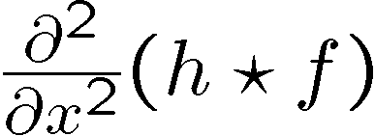
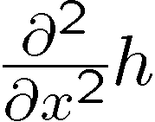
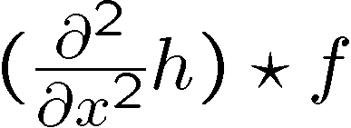
Laplacian of Gaussian
Consider
Laplacian of Gaussian
operator
Where is the edge?
Zero-crossings of bottom graph
Slide credit: Steve Seitz

Slide 17
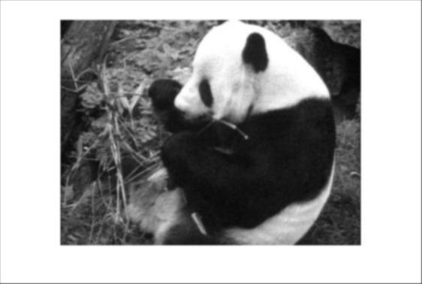
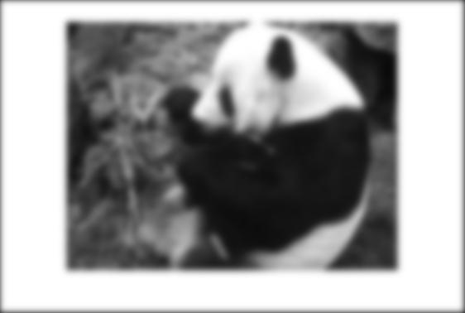
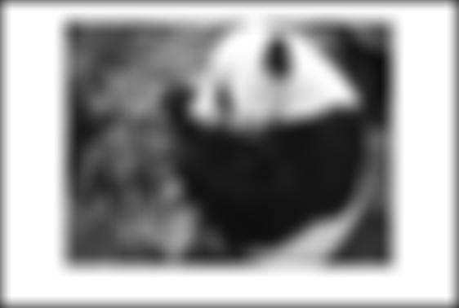
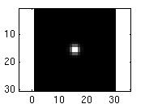
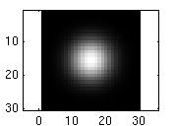
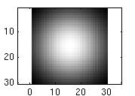
Smoothing with a Gaussian
Recall: parameter σ is the “scale” / “width” / “spread” of the Gaussian kernel, and controls the amount of smoothing.
…
Kristen Grauman, UT-Austin

Slide 18
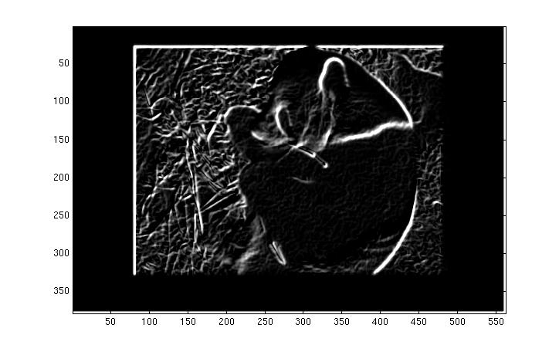
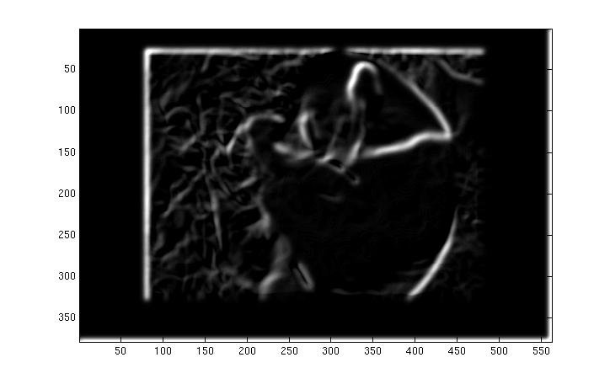
Effect of σ on derivatives
σ = 1 pixel
σ = 3 pixels
The apparent structures differ depending on Gaussian’s scale parameter.
Larger values: larger scale edges detected
Smaller values: finer features detected
Kristen Grauman, UT-Austin

Slide 19
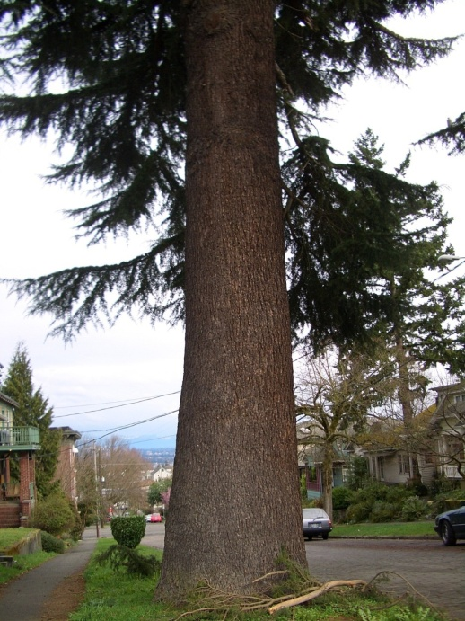
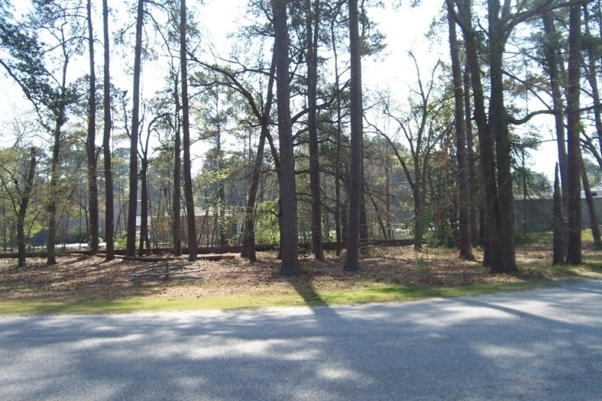
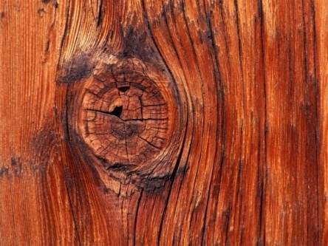

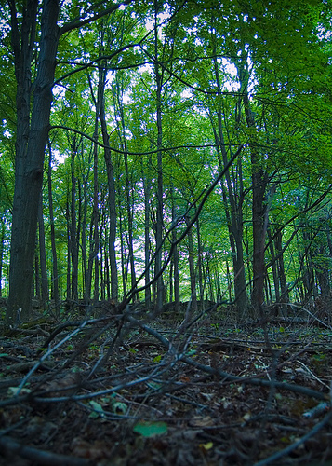
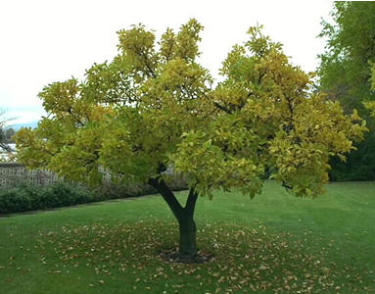

So, what scale to choose?
It depends what we’re looking for.
Kristen Grauman, UT-Austin

Slide 20
Mask properties
Smoothing
Values positive
Sum to 1 → constant regions same as input
Amount of smoothing proportional to mask size
Remove “high-frequency” components; “low-pass” filter
Derivatives
___________ signs used to get high response in regions of high contrast
Sum to ___ → no response in constant regions
High absolute value at points of high contrast
Kristen Grauman, UT-Austin

Slide 21

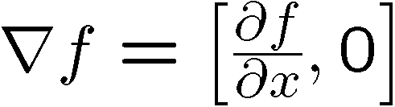
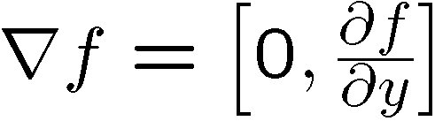
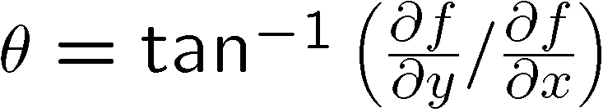
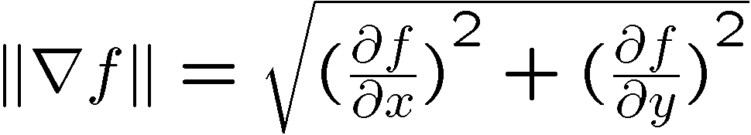
Image gradient
The gradient of an image:
The gradient points in the direction of most rapid change in intensity
Slide credit Steve Seitz
The gradient direction (orientation of edge normal) is given by:
The edge strength is given by the gradient magnitude
Notes:
21

Slide 22
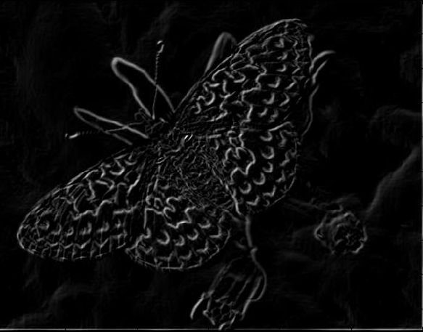
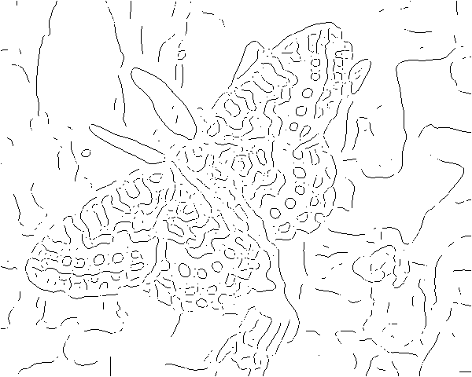
Gradients -> edges
Primary edge detection steps:
1. Smoothing: suppress noise
2. Edge enhancement: filter for contrast
3. Edge localization
Determine which local maxima from filter output are actually edges vs. noise
Threshold, Thin

Slide 23
Thresholding
Choose a threshold value t
Set any pixels less than t to zero (off)
Set any pixels greater than or equal to t to one (on)

Slide 24
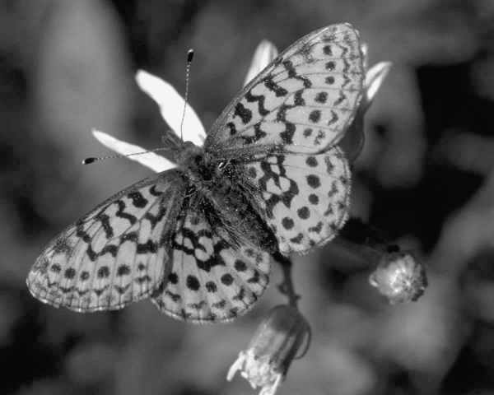
Original image

Slide 25
Gradient magnitude image

Slide 26
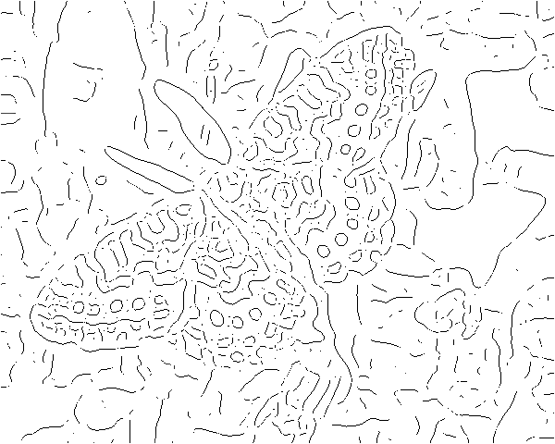
Thresholding gradient with a lower threshold

Slide 27
Thresholding gradient with a higher threshold

Slide 28
Canny edge detector
Filter image with derivative of Gaussian
Find magnitude and orientation of gradient
Non-maximum suppression:
Thin wide “ridges” down to single pixel width
Linking and thresholding (hysteresis):
Define two thresholds: low and high
Use the high threshold to start edge curves and the low threshold to continue them
Source: D. Lowe, L. Fei-Fei

Slide 29

The Canny edge detector
original image (Lena)
Slide credit: Steve Seitz

Slide 30
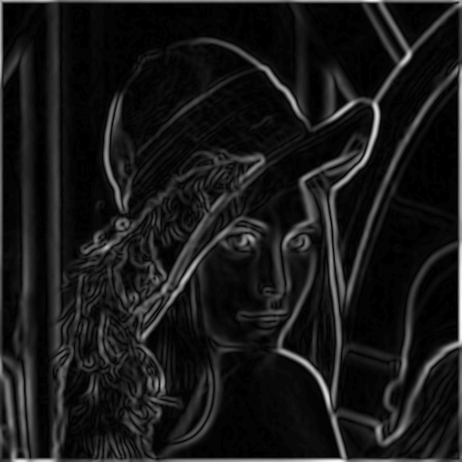
The Canny edge detector
norm of the gradient

Slide 31
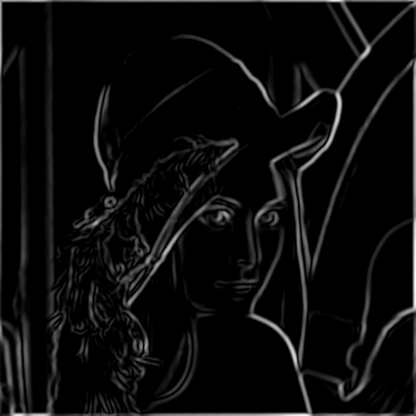
The Canny edge detector
thresholding

Slide 32
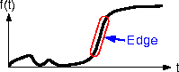
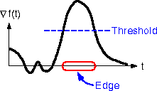
The Canny edge detector
How to turn these thick regions of the gradient into curves?
thresholding

Slide 33
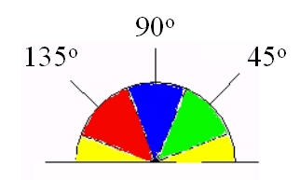
Edge Gradient
Edge direction falling within the yellow range (0 to 22.5 & 157.5 to 180 degrees) is set to 0 degrees.
Falling in the green range (22.5 to 67.5 degrees) is set to 45 degrees.
In the blue range (67.5 to 112.5 degrees) is set to 90 degrees.
Red range (112.5 to 157.5 degrees) is set to 135 degrees.

Slide 34

Non-maximum suppression
Check if pixel is local maximum along gradient direction, select single max across width of the edge
requires checking interpolated pixels p and r

Slide 35
Non-maximum suppression
Given estimates of the image gradients, determine if the gradient magnitude assumes a local maximum in the gradient direction.
Rounded gradient angle is zero degrees
Edge is in the north-south direction
Point considered to be on the edge:
Gradient magnitude > the magnitudes in the west and east directions,
Rounded gradient angle is 90 degrees
Edge is in the east-west direction
Point will be considered to be on the edge
Gradient magnitude > Magnitudes in the north and south directions

Slide 36
Non-maximum suppression
Rounded gradient angle is 135 degrees
Edge is in the north-east-south-west direction
Point considered to be on the edge:
Gradient magnitude > the magnitudes in the north-west and south-east directions,
Rounded gradient angle is 45 degrees
Edge is in the south-east-north-west direction
Point will be considered to be on the edge
Gradient magnitude > Magnitudes in the north-east and south-west directions
From non-maximum suppression, a set of edge points, in the form of a binary image, is obtained. Also, called "thin edges".

Slide 37
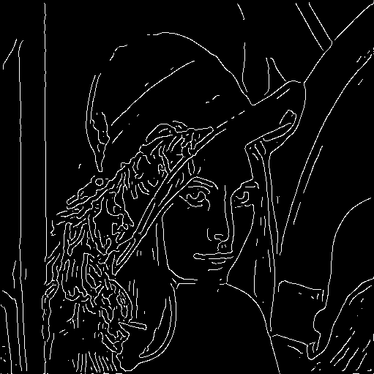
The Canny edge detector
Problem: pixels along this edge didn’t survive the thresholding
thinning
(non-maximum suppression)

Slide 38
Tracing edges through the image
Large intensity gradients more likely to correspond to edges than small intensity gradients.
In most cases impossible to specify a threshold at which a given intensity gradient switches from corresponding to an edge into not doing so.
Canny uses thresholding with hysteresis.
Thresholding with hysteresis requires two thresholds – high and low.
Making the assumption that important edges should be along continuous curves
Follow a faint section of a given line
Discard a few noisy pixels that do not constitute a line but have produced large gradients.

Slide 39
Hysteresis thresholding
Use a high threshold to start edge curves, and a low threshold to continue them.
After this process, we have a binary image where each pixel is marked as either an edge pixel or a non-edge pixel.
Binary edge map obtained in this way -> a set of edge curves, which after further processing can be represented as polygons in the image domain.
Source: Steve Seitz

Slide 40
Hysteresis thresholding
original image
high threshold
(strong edges)
low threshold
(weak edges)
hysteresis threshold
Source: L. Fei-Fei

Slide 41
Hysteresis thresholding
original image
high threshold
(strong edges)
low threshold
(weak edges)
hysteresis threshold
Source: L. Fei-Fei

Slide 42
Recap: Canny edge detector
Filter image with derivative of Gaussian
Find magnitude and orientation of gradient
Non-maximum suppression:
Thin wide “ridges” down to single pixel width
Linking and thresholding (hysteresis):
Define two thresholds: low and high
Use the high threshold to start edge curves and the low threshold to continue them
Source: D. Lowe, L. Fei-Fei

Slide 43
Canny edge detector parameters
Size of the Gaussian filter: smoothing filter used in the first stage directly affects the results of the Canny algorithm.
Smaller filters cause less blurring, and allow detection of small, sharp lines.
Larger filter causes more blurring, smearing out the value of a given pixel over a larger area.
Thresholds: the use of two thresholds with hysteresis allows more flexibility than in a single-threshold approach.
Too high miss important information.
Too low will falsely identify irrelevant information (such as noise) as important.
No generic, automatic solution, yet.
Source: D. Lowe, L. Fei-Fei

Slide 44
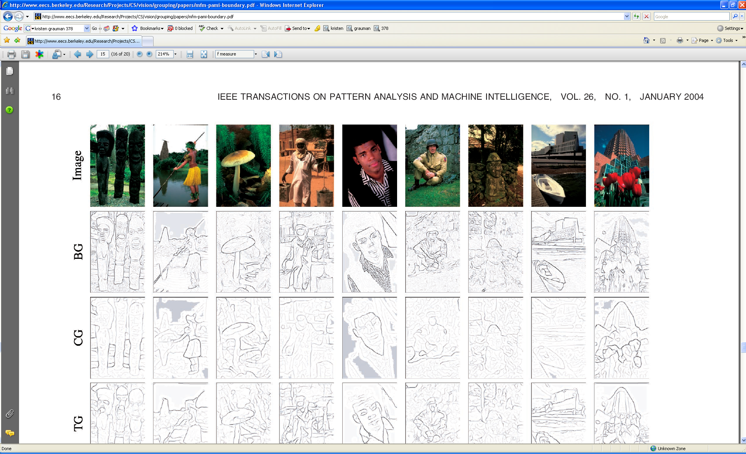





Low-level edges vs. perceived contours
Background
Texture
Shadows
Kristen Grauman, UT-Austin

Slide 45






Low-level edges vs. perceived contours
image
human segmentation
gradient magnitude
Berkeley segmentation database: http://www.eecs.berkeley.edu/Research/Projects/CS/vision/grouping/segbench/
Source: L. Lazebnik

Slide 46

Human-marked segment boundaries
Learn from humans which combination of features is most indicative of a “good” contour?
[D. Martin et al. PAMI 2004]

Slide 47


What features are responsible for perceived edges?
Feature profiles (oriented energy, brightness, color, and texture gradients) along the patch’s horizontal diameter
[D. Martin et al. PAMI 2004]
Kristen Grauman, UT-Austin

Slide 48
What features are responsible for perceived edges?
Feature profiles (oriented energy, brightness, color, and texture gradients) along the patch’s horizontal diameter
[D. Martin et al. PAMI 2004]

Slide 49

[D. Martin et al.
PAMI 2004]

Slide 50

State-of-the-Art in Contour Detection
Canny+opt thresholds
Human agreement
Canny
Prewitt, Sobel, Roberts
Learned with combined features
Source: Jitendra Malik: http://www.cs.berkeley.edu/~malik/malik-talks-ptrs.html

Slide 51
Summary
Filters allow local image neighborhood to influence our description and features
Smoothing to reduce noise
Derivatives to locate contrast, gradient
Convolution properties will influence the efficiency with which we can process images.
Associative
Filter separability
Edge detection processes the image gradient to find curves, or chains of edgels.

Slide 52








Binary images
Kristen Grauman, UT-Austin

Slide 53
Binary image analysis
Basic steps
Convert the image into binary form
Thresholding
Clean up the thresholded image
Morphological operators
Extract separate blobs
Connected components
Describe the blobs with region properties
Kristen Grauman, UT-Austin

Slide 54

Binary images
Two pixel values
Foreground and background
Mark region(s) of interest

Slide 55



Thresholding
Grayscale -> binary mask
Useful if object of interest’s intensity distribution is distinct from background
Example http://homepages.inf.ed.ac.uk/rbf/CVonline/LOCAL_COPIES/FITZGIBBON/simplebinary.html

Slide 56
Thresholding
Given a grayscale image or an intermediate matrix → threshold to create a binary output.
Example: edge detection
Gradient magnitude
Looking for pixels where gradient is strong.

Slide 57




Thresholding
Given a grayscale image or an intermediate matrix → threshold to create a binary output.
Example: background subtraction
-
=
Looking for pixels that differ significantly from the “empty” background.
Kristen Grauman, UT-Austin

Slide 58


Thresholding
Given a grayscale image or an intermediate matrix → threshold to create a binary output.
Example: intensity-based detection
Looking for dark pixels
Kristen Grauman, UT-Austin

Slide 59


Thresholding
Given a grayscale image or an intermediate matrix → threshold to create a binary output.
Example: color-based detection
fg_pix = find(hue > t1 & hue < t2);
Looking for pixels within a certain hue range.
Kristen Grauman, UT-Austin

Slide 60

A nice case: bimodal intensity histograms
Ideal histogram, light object on dark background
Actual observed histogram with noise
Images: http://homepages.inf.ed.ac.uk/rbf/CVonline/LOCAL_COPIES/OWENS/LECT2/node3.html

Slide 61


Not so nice cases
Shapiro and Stockman

Slide 62
Issues
What to do with “noisy” binary outputs?
Holes
Extra small fragments
How to demarcate multiple regions of interest?
Count objects
Compute further features per object
Kristen Grauman, UT-Austin

Slide 63
Morphological operators
Change the shape of the foreground regions via intersection/union operations between a scanning structuring element and binary image.
Useful to clean up result from thresholding
Basic operators are:
Dilation
Erosion

Slide 64


Dilation
Expands connected components
Grow features
Fill holes
Before dilation
After dilation
Kristen Grauman, UT-Austin
Notes:
Disk strel, 5 pixels wide

Slide 65


Erosion
Erode connected components
Shrink features
Remove bridges, branches, noise
Before erosion
After erosion
Kristen Grauman, UT-Austin

Slide 66

Structuring elements
Masks of varying shapes and sizes used to perform morphology, for example:
Scan mask across foreground pixels to transform the binary image
Kristen Grauman, UT-Austin

Slide 67
Dilation vs. Erosion
At each position:
Dilation: if current pixel is foreground, OR the structuring element with the input image.

Slide 68
Example for Dilation (1D)
Input image
1 | 0 | 0 | 0 | 1 | 1 | 1 | 0 | 1 | 1
1
1
1
Structuring Element
Output Image
1 | 1
Adapted from T. Moeslund

Slide 69
Example for Dilation
Input image
1 | 0 | 0 | 0 | 1 | 1 | 1 | 0 | 1 | 1
Structuring Element
1
1
1
Output Image
1 | 1

Slide 70
Example for Dilation
Input image
1 | 0 | 0 | 0 | 1 | 1 | 1 | 0 | 1 | 1
Structuring Element
1
1
1
Output Image
1 | 1 | 0

Slide 71
Example for Dilation
Input image
1 | 0 | 0 | 0 | 1 | 1 | 1 | 0 | 1 | 1
Structuring Element
1
1
1
Output Image
1 | 1 | 0 | 0

Slide 72
Example for Dilation
Input image
1 | 0 | 0 | 0 | 1 | 1 | 1 | 0 | 1 | 1
Structuring Element
1
1
1
Output Image
1 | 1 | 0 | 1 | 1 | 1

Slide 73
Example for Dilation
Input image
1 | 0 | 0 | 0 | 1 | 1 | 1 | 0 | 1 | 1
Structuring Element
1
1
1
Output Image
1 | 1 | 0 | 1 | 1 | 1 | 1

Slide 74
Example for Dilation
Input image
1 | 0 | 0 | 0 | 1 | 1 | 1 | 0 | 1 | 1
Structuring Element
1
1
1
Output Image
1 | 1 | 0 | 1 | 1 | 1 | 1 | 1

Slide 75
Example for Dilation
Input image
1 | 0 | 0 | 0 | 1 | 1 | 1 | 0 | 1 | 1
Structuring Element
1
1
1
Output Image
1 | 1 | 0 | 1 | 1 | 1 | 1 | 1

Slide 76
Example for Dilation
Input image
1 | 0 | 0 | 0 | 1 | 1 | 1 | 0 | 1 | 1
Structuring Element
1
1
1
Output Image
1 | 1 | 0 | 1 | 1 | 1 | 1 | 1 | 1 | 1
Note that the object gets bigger and holes are filled.

Slide 77

2D example for dilation
Shapiro & Stockman

Slide 78
Dilation vs. Erosion
At each position:
Dilation: if current pixel is foreground, OR the structuring element with the input image.
Erosion: if every pixel under the structuring element’s nonzero entries is foreground, OR the current pixel with S.

Slide 79
Example for Erosion (1D)
Input image
1 | 0 | 0 | 0 | 1 | 1 | 1 | 0 | 1 | 1
1
1
1
Structuring Element
_
Output Image
0

Slide 80
Example for Erosion (1D)
Input image
1 | 0 | 0 | 0 | 1 | 1 | 1 | 0 | 1 | 1
1
1
1
Structuring Element
_
Output Image
0 | 0

Slide 81
Example for Erosion
Input image
1 | 0 | 0 | 0 | 1 | 1 | 1 | 0 | 1 | 1
Structuring Element
1
1
1
Output Image
0 | 0 | 0

Slide 82
Example for Erosion
Input image
1 | 0 | 0 | 0 | 1 | 1 | 1 | 0 | 1 | 1
Structuring Element
1
1
1
Output Image
0 | 0 | 0 | 0

Slide 83
Example for Erosion
Input image
1 | 0 | 0 | 0 | 1 | 1 | 1 | 0 | 1 | 1
Structuring Element
1
1
1
Output Image
0 | 0 | 0 | 0 | 0

Slide 84
Example for Erosion
Input image
1 | 0 | 0 | 0 | 1 | 1 | 1 | 0 | 1 | 1
Structuring Element
1
1
1
Output Image
0 | 0 | 0 | 0 | 0 | 1

Slide 85
Example for Erosion
Input image
1 | 0 | 0 | 0 | 1 | 1 | 1 | 0 | 1 | 1
Structuring Element
1
1
1
Output Image
0 | 0 | 0 | 0 | 0 | 1 | 0

Slide 86
Example for Erosion
Input image
1 | 0 | 0 | 0 | 1 | 1 | 1 | 0 | 1 | 1
Structuring Element
1
1
1
Output Image
0 | 0 | 0 | 0 | 0 | 1 | 0 | 0

Slide 87
Example for Erosion
Input image
1 | 0 | 0 | 0 | 1 | 1 | 1 | 0 | 1 | 1
Structuring Element
1
1
1
Output Image
0 | 0 | 0 | 0 | 0 | 1 | 0 | 0 | 0

Slide 88
Example for Erosion
Input image
1 | 0 | 0 | 0 | 1 | 1 | 1 | 0 | 1 | 1
Structuring Element
1
1
1
Output Image
0 | 0 | 0 | 0 | 0 | 1 | 0 | 0 | 0 | 1
Note that the object gets smaller.

Slide 89
2D example for erosion
Shapiro & Stockman

Slide 90

Opening
Erode, then dilate
Remove small objects, keep original shape
Before opening
After opening

Slide 91

Closing
Dilate, then erode
Fill holes, but keep original shape
Before closing
After closing
Applet: http://bigwww.epfl.ch/demo/jmorpho/start.php

Slide 92



Morphology operators on grayscale images
Dilation and erosion typically performed on binary images.
If image is grayscale: for dilation take the neighborhood max, for erosion take the min.
original
dilated
eroded
Kristen Grauman, UT-Austin

Slide 93
Issues
What to do with “noisy” binary outputs?
Holes
Extra small fragments
How to demarcate multiple regions of interest?
Count objects
Compute further features per object
Kristen Grauman, UT-Austin

Slide 94
Connected components
Various algorithms to compute
Recursive (in memory)
Two rows at a time (image not necessarily in memory)
Parallel propagation strategy

Slide 95
Recursive connected components
Find an unlabeled pixel, assign it a new label
Search to find its neighbors, and recursively repeat to find their neighbors til there are no more
Repeat
Demo http://www.cosc.canterbury.ac.nz/mukundan/covn/Label.html

Slide 96

Connected components
Identify distinct regions of “connected pixels”
Shapiro and Stockman

Slide 97

Connectedness
Defining which pixels are considered neighbors
4-connected
8-connected
Source: Chaitanya Chandra

Slide 98

Connected components
We’ll consider a sequential algorithm that requires only 2 passes over the image.
Input: binary image
Output: “label” image, where pixels are numbered per their component
Note: foreground here is denoted with black pixels.

Slide 99

Sequential connected components
Adapted from J. Neira

Slide 100
Sequential connected components

Slide 101
Sequential connected components

Slide 102
Sequential connected components

Slide 103

Connected components
Slide credit: Pinar Duygulu

Slide 104
Region properties
Given connected components, can compute simple features per blob, such as:
Area (num pixels in the region)
Centroid (average x and y position of pixels in the region)
Bounding box (min and max coordinates)
Circularity (ratio of mean dist. to centroid over std)
A2=170
A1=200
Kristen Grauman, UT-Austin

Slide 105
Binary image analysis: (recap)
Convert the image into binary form
Thresholding
Clean up the thresholded image
Morphological operators
Extract separate blobs
Connected components
Describe the blobs with region properties

Slide 106

Example : segmentation of a liver
Slide credit: Li Shen

Slide 107






Example: Bg subtraction + blob detection
…

Slide 108

Example : Bg subtraction + blob detection
University of Southern California
http://iris.usc.edu/~icohen/projects/vace/detection.htm

Slide 109
Binary images
Pros
Can be fast to compute, easy to store
Simple processing techniques available
Lead to some useful compact shape descriptors
Cons
Hard to get “clean” silhouettes
Noise common in realistic scenarios
Can be too coarse of a representation
Not 3d
Kristen Grauman, UT-Austin

Slide 110
Summary
Operations, tools
Features, representations
Derivative filters
Smoothing, morphology
Thresholding
Connected components
Matched filters
Histograms
Edges, gradients
Blobs/regions
Local patterns
Textures (next)
Color distributions

